Slide 1
Sentence Structure
Common Errors in
Composing a sentence

Slide 2
Run-On Sentence
Sometimes referred to as a FUSED SENTENCE
A writer tries to join two independent clauses (IC’s) without proper conjunctions or punctuation.
Example:
I tried to run up the stairs I stubbed my toe and fell forward.

Slide 3
Correction Options
Make the run-on into 2 separate sentences:
Example:
I tried to run up the stairs. I stubbed my toe and fell forward.
Use a semi-colon:
Example:
I tried to run up the stairs; I stubbed my toe and fell forward.

Slide 4
Correction Options
Use a comma and coordinating conjunction:
Use an acronym to remember the coordinating conjunctions: FANBOYS
For
And
Nor
But
Or
Yet
So

Slide 5
Correction using comma and Fanboys
Example:
I tried to run up the stairs, but I stubbed my toe and fell forward.

Slide 6
Comma Splice: Another common error
Joining 2 independent clauses with a comma.
A comma is not a strong enough punctuation mark to connect 2 IC’s.
Example:
I tried to run up the stairs, I stubbed my toe and fell forward.

Slide 7
Correction:
Use the 4 techniques listed for run-on sentences to correct:
Two separate sentences
Comma and coordinationg conjunction
(FANBOYS)
Semi-colon
Dependent clause

Slide 8
Fragment Another sentence error
A fragment is an incomplete idea that tries to stand alone as a sentence.
Example:
Because I tried to run up the stairs.
When I stubbed my toe.

Slide 9
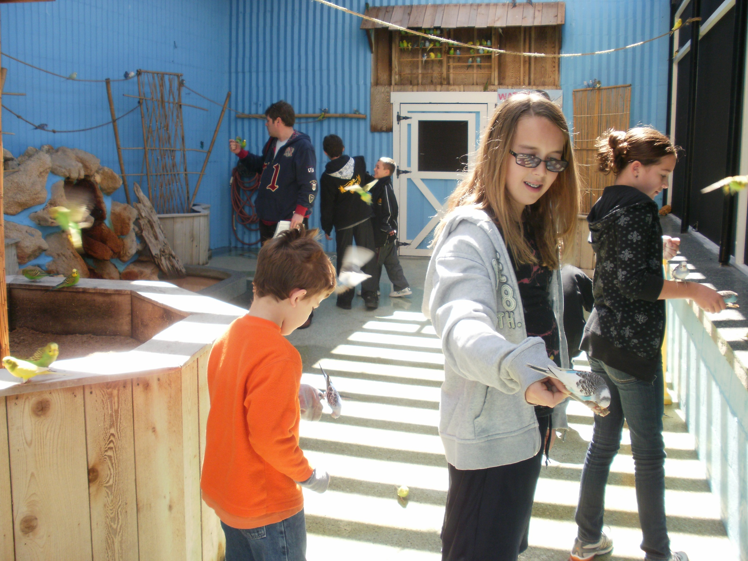

Slide 10
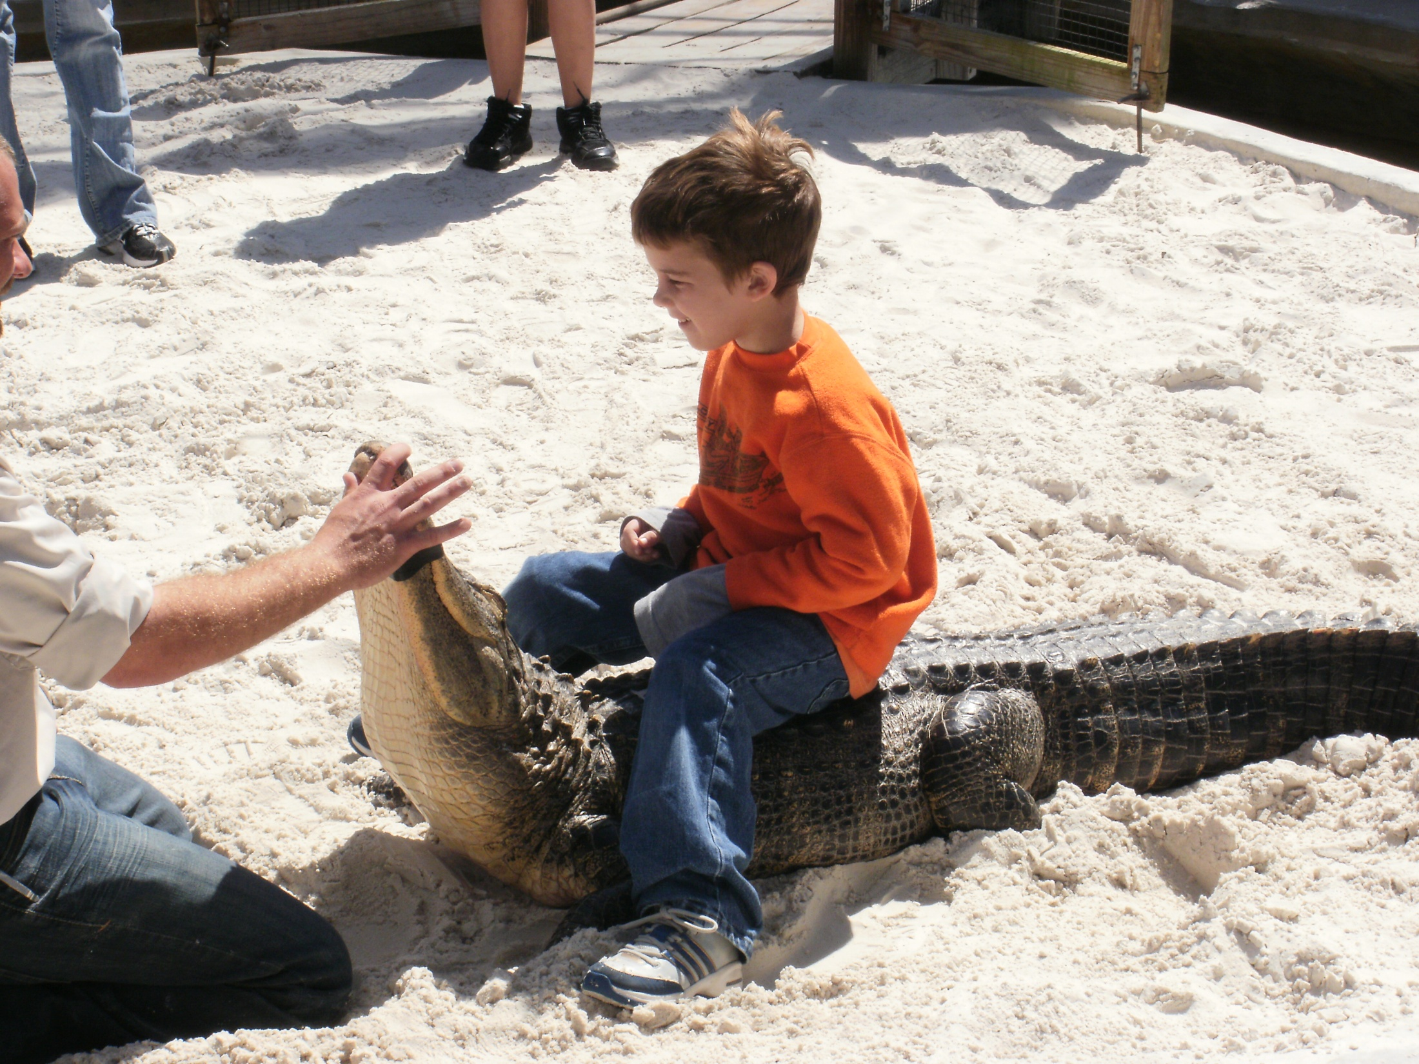

Slide 11
Combining Clauses with Coordination
When we combine 2 independent clauses (IC’s) through the use of FANBOYS or semi-colons.
Example:
May loves to cook, and John loves to clean.
May loves to cook; John loves to clean.

Slide 12
Combining Clauses with Subordination
When an Independent Clause (IC)and a Dependent Clause (DC) are joined to make a complete sentence.
Example:
If Mary will cook, John will clean.
John will clean if Mary will cook.
The sentence is punctuated with a comma only if the DC come first.

Slide 13
Subordination
Remember!
DC, IC (use comma)
IC DC (no comma)

Slide 14
Coordination/ Subordination
Practice
1. While Herb took a nap we watched TV.
2. We will go to the mall after we clean up.
3. Unless we study we will not pass the test.
4. Although I’m tired I must study.
5. I enjoyed the dance after we played the
game.

Slide 15
Grammatical Sentences:
Must have a subject and a verb
Must express a complete thought

Slide 16
Types of Sentences
Simple Sentence
A sentence that has one subject and only one verb, either of which may be compound. It consists of one and only one independent clause.
Example:
John joined the Marines.
Joe and Marsha played and laughed.

Slide 17
Types of Sentences
2. Compound Sentence:
A sentence that contains two or more simple sentences (IC’s), usually joined by a comma and a connecting word (FANBOYS), or a semicolon.
Examples:
He called the children for supper, but they could not hear him.
He called the children to supper; they could not hear him.

Slide 18
Types of Sentences
Complex Sentence
A sentence that has one independent clause and one or more dependent clauses.
Examples:
Although it snowed, the schools were open.
We did our homework while Mom slept.

Slide 19
Diagram of Sentence Forms
INDEPENDENT DEPENDENT
Simple 1 0
Compound 2 or more 0
Complex 1 1 or more

